Slide 1

Clock Tree Synthesis and Static Timing Analysis of Finite State Machine-Based Digital Circuits
2310040063 – S.Shushmitha
2310040064 - M.Gayathri
2310040068 – T.Keerthi

Slide 2
Introduction
Clock plays a critical role in digital circuits
Improper clock distribution leads to:
Clock skew
Setup & hold violations
Clock Tree Analysis (CTA) ensures reliable operation
This project analyzes clock behavior in a FSM based digital circuit.

Slide 3
Objectives
To design an FSM-based traffic light controller with clearly defined states and transitions.
To implement Clock Tree Synthesis (CTS) for the FSM-based digital circuit to ensure efficient and balanced clock distribution.
To analyze and minimize clock skew and clock latency using proper clock tree structures and buffer insertion.
To perform Static Timing Analysis (STA) before and after CTS to verify setup and hold time constraints.
To achieve timing closure and reliable operation of the digital circuit at the desired clock frequency.

Slide 4
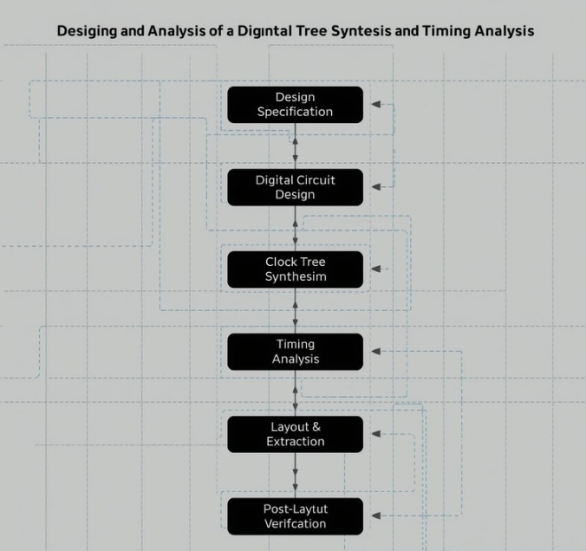

Slide 5
Literature survey
Finite State Machines (FSMs) are widely used for control applications such as traffic light controllers due to their clear state-based operation.
Highlights that Clock Tree Synthesis is a critical step in synchronous digital design to distribute the clock evenly and reduce clock skew.
Research indicates that improper clock distribution can cause setup and hold time violations, affecting the reliability of FSM-based circuits.
Studies confirm that applying CTS and STA improves performance and timing reliability in control-oriented digital circuits such as traffic controllers.

Slide 6
Methodology
FSM Design and RTL Development
Functional Simulation and Verification
Logic Synthesis
Pre-CTS Static Timing Analysis
Clock Tree Synthesis (CTS)
Post-CTS Static Timing Analysis and Validation

Slide 7
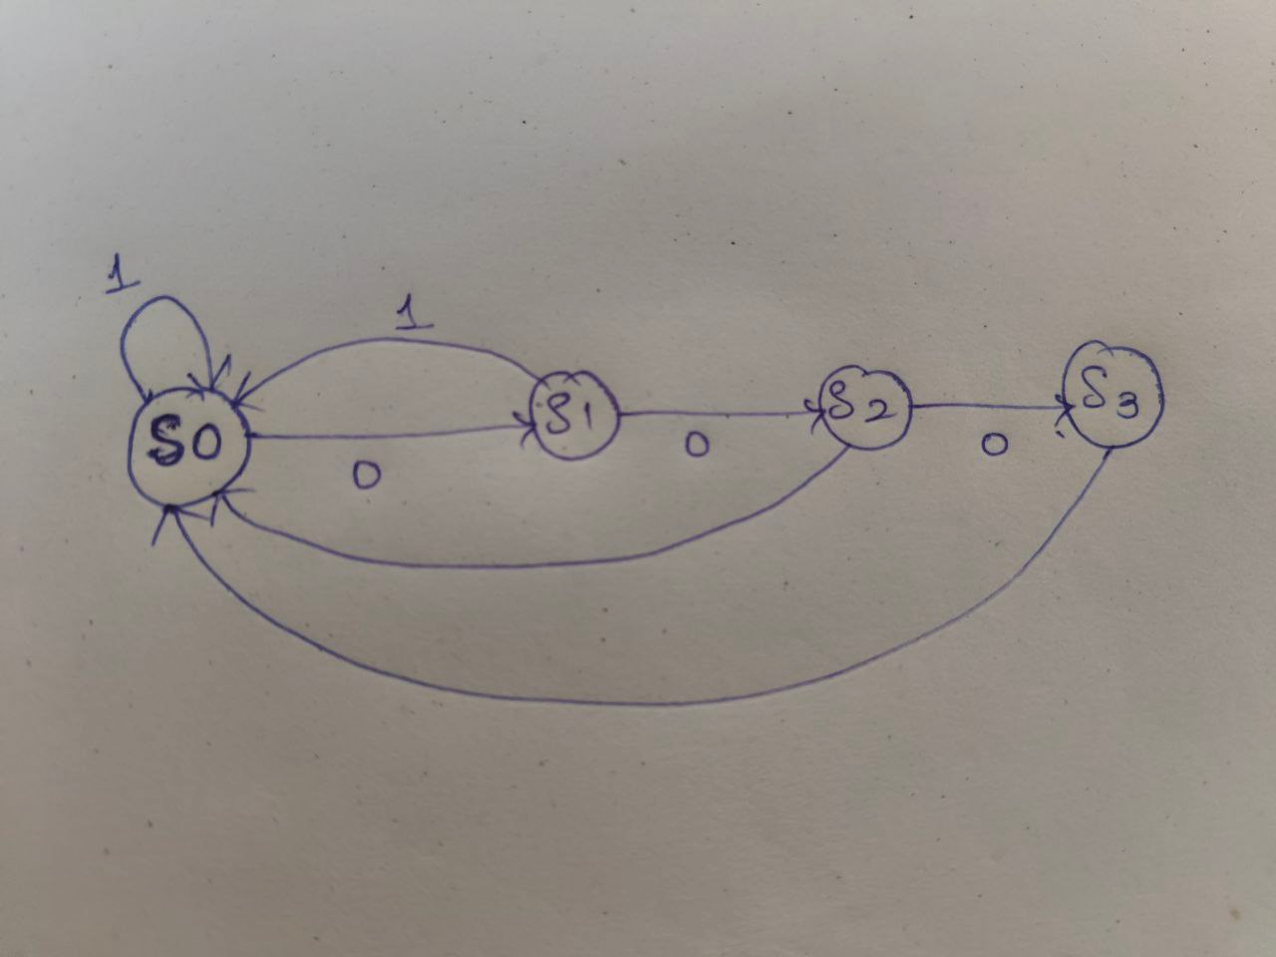
States and Transistions
Inputs : clk,reset
S0 : A_green,B_red = 00
S1 : A_yellow,B_red = 01
S2 : A_red,B_green = 10
S3 : A_red,B_yellow = 11

Slide 8
Expected Outcomes
Designed an FSM-based digital circuit using HDL (Verilog/VHDL).
Implemented Clock Tree Synthesis (CTS) to achieve balanced clock distribution with reduced skew
Performed Static Timing Analysis (STA) to validate setup and hold timing constraints.
Analyzed clock impact on power and area, understanding real ASIC design trade-offs.

Slide 9


